Slide 1

Department of Computer Science & Engineering
“Analyzing people’s behavior from media”
UNDER THE GUIDANCE OF
Mrs. Soniya Komal V
Asst. Professor,
Dept. of Computer Science
Presented By
PRADAAP.S.S
SANGAMESH
T N VARSHA
VIKRAM SRI
[1RG16CS067] [1RG16CS083] [1RG16CS103] [1RG16CS108]

Slide 2
CONTENTS
Introduction
Technology Used
Motivation
Problem Identification
Objective
Existing system & disadvantages, Proposed system & advantages
Identification of Modules
Architecture
Sequence Diagram
Outcomes of the project
Future scope
Conclusion

Slide 3
INTRODUCTION
Emotion plays a significant role in daily interpersonal human interactions. This is essential to our rational as well as intelligent decisions. It helps us to match and understand the feelings of others by conveying our feelings and giving feedback to others. We analyze people's usage pattern in three major arenas, the most widely audio, video and text. We extract linguistic features and infer personality traits from all the three of these modules. Our study reveals differential relationship between personality traits. Combination of these three profiles gives an extensive view of a user's interest and sensitivity.

Slide 4
TECHNOLOGY USED
Machine learning:
Machine Learning is an application of Artificial Intelligence that provides the system the ability to automatically learn and improve from experience without being explicitly programmed.
Emotion from the surface of it does not look like a very direct problem. Most datasets are labelled as Valence scores to capture emotion. A lot of feature engineering was involved in training these algorithms earlier.
Training classifiers involves making emotion word lists, deciding what features to use to classify and then train an SVM.
We also build a CNN Model to categorize the different emotions from the audio features

Slide 5
Python:
sentiment analysis classification model categorizes texts, and you want to automate access to the model, and programmatically perform sentiment analysis.
Python programming language has a special library for sentiment analysis, textBlob. This library analysis the emotion through text having subjective and objective perspectives for each word , and rating them accordingly for an accurate outcome.

Slide 6
MOTIVATION
Psychometric test is a standard and traditional test which contains multiple choice questions. The user is asked to choose one option out of many. This test is be used identify candidate’s personality, characteristics and attitude. It is difficult to identify hidden aspect of a candidate which can be only by face to face interview. Another traditional approach is face to face interview which involves extra man power and time. All these issues can be resolved through this project.
The idea behind creating this project was to build a machine learning model that could detect emotions from the speech, text and video we have with each other all the time. Nowadays personalization is something that is needed in all the things we experience every day. So why not have a emotion detector that will gauge your emotions and in the future recommend you different things based on your mood.

Slide 7
PROBLEM IDENTIFICATION
After going through various research paper’s and patent documents we observed that there previous research’s are focused on posts/comments, MCQ questions, image processing, etc. Here we are trying to improve the efficiency of behavioural analysis by combing Social Networking Sites posts along with Media/Video processing. So we can screen out people more efficiently and grade them properly..
Image processing: Nowadays, people share a lot of content on social media in the form of images - be it personal, or everyday scenes, or their opinions depicted in the form of cartoons or memes. Also, it would be useful to understand the emotion an image depicts to automatically predict emotional tags on them - like happiness, etc.
Machine learning for voice recognition: The reason is that deep learning finally made speech recognition accurate enough to be useful outside of carefully controlled environment.

Slide 8
OBJECTIVES
The main objective of this project is to analyze people’s behavior from media either live (for not so active social media users) or uploaded media by splitting media into its different constituents like video, audio and text. Analyzing these parts separately for behavior analysis in order to extract as accurate outcome as possible.

Slide 9
EXISTING SYSTEM AND DISADVANTAGES
In Existing System, project aimed to study analyze people’s behavior through separate platforms for each of text, speech and images only. The existing model gives an option to upload a picture and it will analyze and predict your emotion like Happy, Angry, Neutral, surprise, sad and fear. Also, through a form of questionnaire based on the responses the emotion will be detected.

Slide 10
DISADVANTAGES:
After processing the image, the result displays a mixed of emotions even a person is completely happy or sad. Also, it is not using face detection algorithm. Thus, when giving an image of any object or place as input, it is still showing emotions in percentage even when the image does not have any face in it.
In questionnaire responses the users can manipulate their responses according to their likes thus decreasing the accuracy. A platform for analyzing video data with accurate results was not possible in the previously designed model.

Slide 11
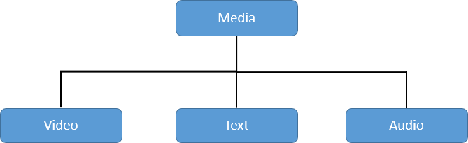
PROPOSED SYSTEM
The proposed system will analyze and predict the user behavior. For this purpose, the system will take user’s data from media. The collected data is then analyzed and classified.
Figure: Proposed System

Slide 12
ADVANTAGES:
The input is divided into separate modules and each separate module is analyzed with the algorithms specialized specific for that module.
The highest optimal emotion is highly accurate as each module’s optimal emotion is compared ; expected outcome v/s actual outcome.
The input can be either live or stored video, thus making this designed model an on- spot emotion detector.

Slide 13
IDENTIFICATION OF MODULES
Text Module: Data will be analyzed through textBlob library of python.
Video Module: We will use Support Vector Machine (SVM) algorithm. Initially the relevant regions are targeted and the unwanted regions are ignored, then required features will be extracted and then SVM will analyze and classify the sentiments.
Audio Module: Audio can be used to analyze sentiments just like text and media is used. In audio module voice is extracted from the video and then features were extracted using by plotting its waveform and spectrogram

Slide 14
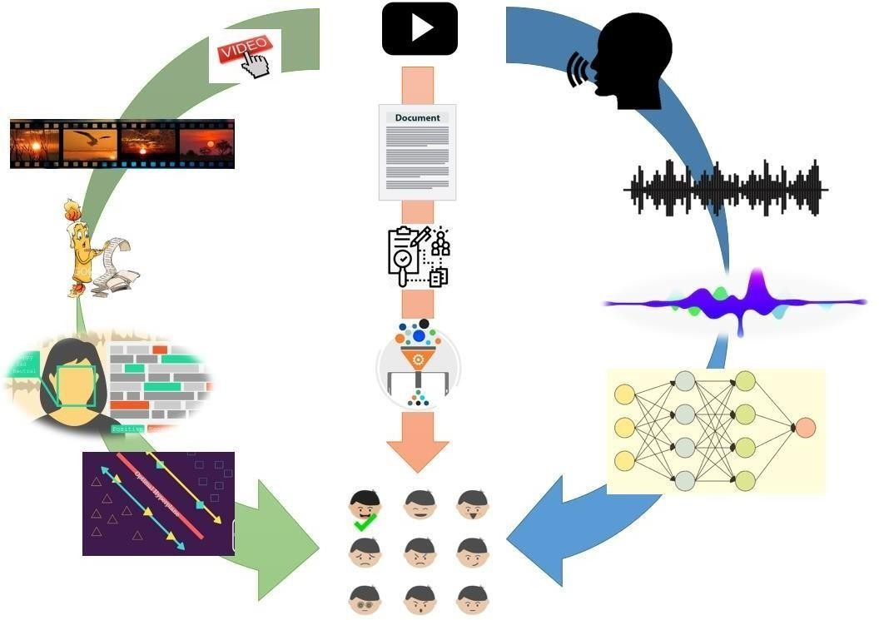
ARCHITECTURE DIAGRAM
Figure: System architecture

Slide 15
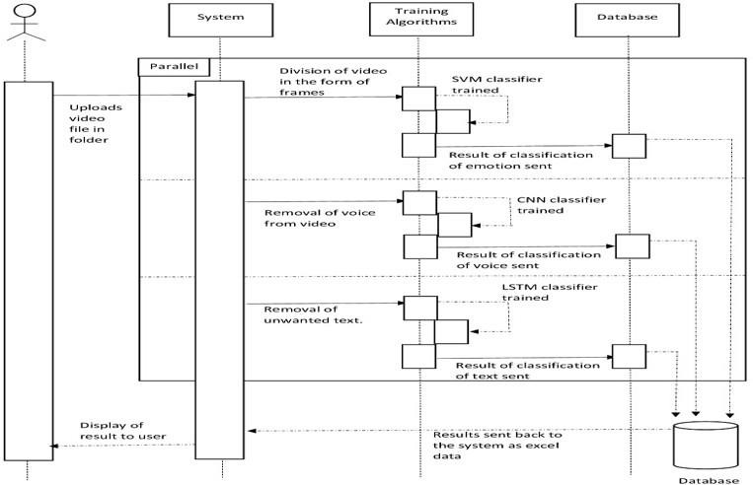
SEQUENCE DIAGRAM
Text Blob
Figure :Sequence diagram

Slide 16
OUTCOME OF THE PROJECT
In this project we are taking media file as input then we separate frames, voice and text from media. Then analyzing each separated part for persons sentimental characteristics. There are separate modules for analyzing each part using best algorithms. Also, checking and comparing the module’s output with expected output for detecting highest optimal output.
Highest optimal emotion detected: After each module is divided into respective audio, video and text, each module after processed with specialized give individual module inputs out of which the highest optimal dominant emotion is detected.
Efficient and quick outputs: For the non- social media users, simple recorded videos are accepted as input to this model and the emotion is detected within short span of seconds.

Slide 17
CSV File: The outcomes of each module and in last we represent them module in csv file against there input file which gives overall insight about the characteristics of person’s in that file.
Graphs: Each of the csv filed outcomes are plotted on graph for accuracy checks ,expected v/s actual outcome.

Slide 18
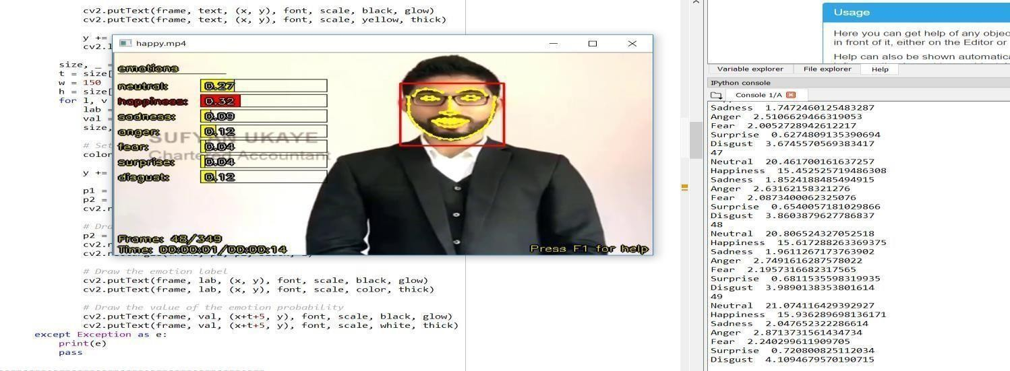
RESULTS
Video module
Figure : Emotions extracted from video frames

Slide 19
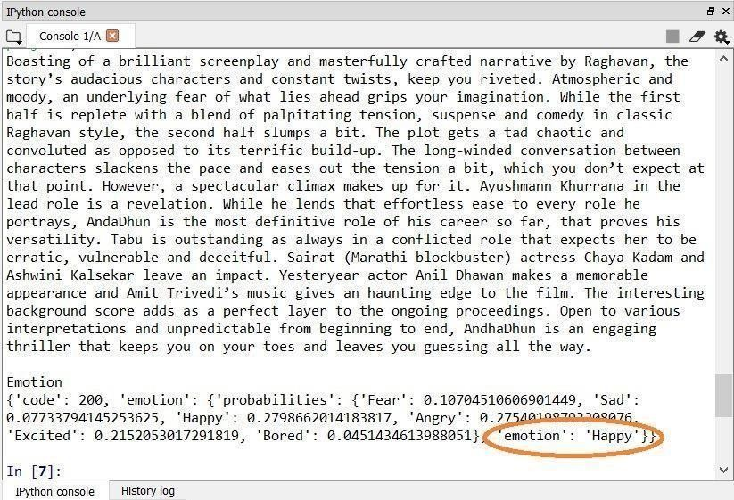
Text module
Figure : Emotions extracted from text

Slide 20
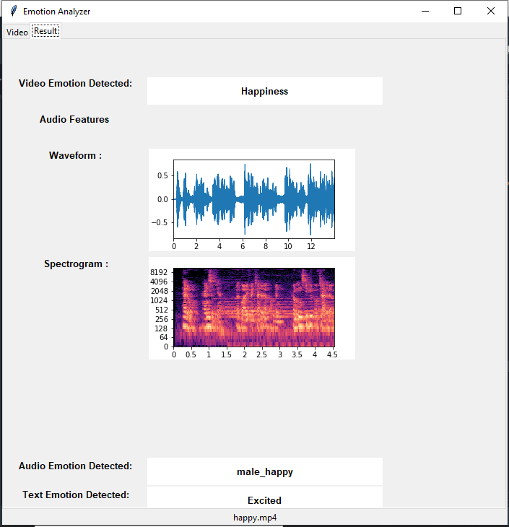
Audio module
Figure : Emotions extracted from audio

Slide 21
FUTURE SCOPE
As future work, we intend to perform experiments and expand sentiment analysis on different areas and datasets. Video module can be further enhanced for overcoming skipping issue and some work is required over voice part so that it can generate accurate outcomes even in noise full environment.
The technology is also used to infuse customer experiences, apps and interactive advertising with Emotion AI.
Psychometric test along with Emotion AI can be used to identify the hidden aspect of a candidate(personality, character and attitude).
Presently, emotional states of research participants using automated analysis of text responses to questions regarding the pandemics.

Slide 22
CONCLUSION
We were successfully able to extract emotions from different parts of a media file such as video, audio and text. We were also successful in getting the best optimal emotion for each modules of the media file under consideration. We were able to represent outcomes of input files module wise into csv file which can be further analyzed for more insights and decision makings. We have faced certain issues during this project like person should continuously maintain eye contact with webcam otherwise frames are skipped. In voice analysis, voice should be clear and loud and without noise.

Slide 23
THANK YOU

